Slide 1


Enhanced FIR Filter Design Using Hybrid Adders and Multipliers
Department of Electronics and Communication Engineering
Presented by:
P. Tharun A21126512164
P. Rohan Kumar A21126512162
L. Sanjay A21126512150
K. Himakar A21126512148
Under The Guidance of:
Mr. N. Srinivasa Naidu
Assistant Professor
B.Tech, M.Tech, (Ph.D)

Slide 2


Abstract
The design of FIR filters is critical in digital signal processing applications, particularly for improving power efficiency and speed. This project aims to further enhance the effectiveness of FIR filter designs by addressing current challenges in power efficiency and delay. The objective is to minimize power consumption by employing hybrid adder and multiplier structures that optimize speed and power dissipation characteristics. The central innovation is the creation of hybrid arithmetic units: a 32-bit hybrid adder and a 16-bit hybrid multiplier designed to reduce power-delay product (PDP) with high-speed capabilities. The hybrid adder is built by combining Ling and Sparse Kogge-Stone (SKSA) adder topologies, taking advantage of their complementary properties to minimize critical path delay and switching activity. The hybrid multiplier utilizes a 4-chain tree addition method, summing up partial products in an efficient manner with serially configured hybrid adders. These specialized arithmetic blocks were simulated with Verilog HDL and synthesized with the Xilinx Vivado 2024.1 toolchain. All simulations and synthesis processes were carried out targeting the Artix-7 FPGA (Part: xc7a50tcpg236-1), a popular mid-range FPGA from AMD Xilinx. Rigorous testing and simulation validate the functional correctness and superior performance of the proposed FIR filter, demonstrating significant improvements in delay and power consumption for high-performance DSP applications.

Slide 3
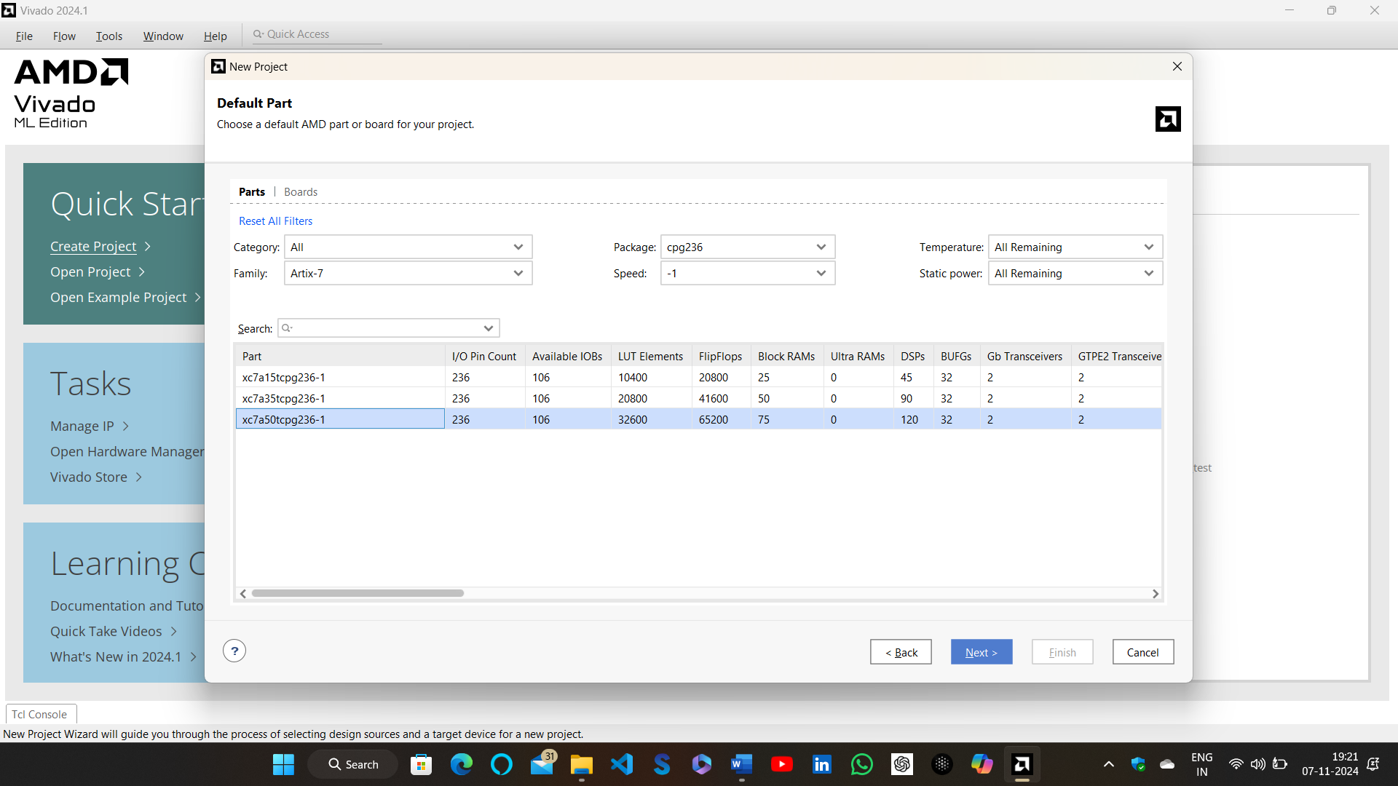
FPGA BOARD USED FOR SIMULATION

Slide 4

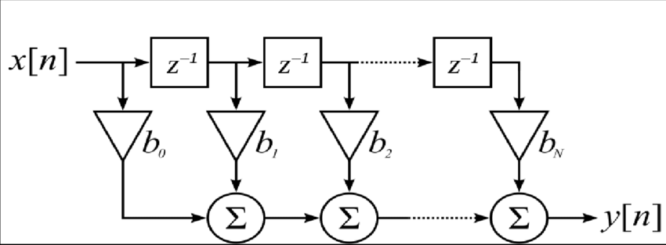
INTRODUCTION
A FIR Filter consists of 3 main components:
D Flip–Flop: to implement a simple delay
Adder: to sum the nodes at the end of each tap
Multiplier: to implement the coefficients
Uniqueness:
This enhanced FIR filter design stands out due to its hybrid adder-multiplier architecture, which significantly reduces power consumption and computational delay compared to conventional designs. The integration of a Ling adder and a Sparse Kogge-Stone adder optimizes carry propagation, while a custom hybrid multiplier accelerates multiplication operations. Additionally, the parallel-serial combination tree efficiently sums filter outputs, enhancing processing speed.
Fig: FIR Filter Block Diagram

Slide 5
Methodology
[1]Hybrid Adder Design:
Investigate multiple conventional adder architectures, including Brent-Kung Adders (BKAs), Kogge Stone Adder(KSA), Ling Adders, Sparse Kogge Stone Adder(SKSA), and various combinations of these adders.
Simulate these adders to assess area, delay, and power consumption for each combination to find the best combination.
[2]Hybrid Multiplier Design:
Explore various traditional multipliers and integrate them with the selected hybrid adders.
Evaluate trade-offs between performance and computational complexity to identify the most efficient multiplier design.
[3]FIR Filter Optimization:
Select the optimal adder–multiplier pair based on a comprehensive analysis of area, speed, and power consumption.
Develop a tailored filter structure incorporating the chosen hybrid adder and multiplier modules.
Validate the functionality of the proposed FIR filter through rigorous simulation and testing.

Slide 6
REFERENCE TABLE
Reference | Power (mW) | Slices | LUTs | Delay (ns) | Board | Simulation Tools | Comments
1. Sinthura et al. (ICOEI 2018) | 120 | 450 | 1500 | 18.7 | Xilinx Virtex-7 | Xilinx Vivado | Booth, Vedic, Wallace Tree analyzed.
2. Yong et al. (2021) | 115 | 430 | 1480 | 19.2 | Spartan-6 | Xilinx Vivado | Combines Booth encoding with Wallace reduction.
3. Deshpande & Mahajan | 110 | 420 | 1450 | 17.5 | Spartan-3E | Xilinx ISE | Optimized using Vedic mathematics.
4. Nisha & Valamarthy | 105 | 410 | 1430 | 16.8 | Virtex-6 | Xilinx ISE, ModelSim | Hybrid Vedic and Karatsuba approach.
5. Srinivasan & Prakasam | N/A | 440 | 1445 | 18.2 | Not specified | Not specified | Survey on low-power designs.
6. Shah et al. (MCCT'14) | 98 | 405 | 1400 | 22.8 | Spartan-3E | Xilinx ISE | FPGA-based Vedic multiplier implementation.
7. Bala Murugesh et al. | 102 | 400 | 1390 | 20.5 | Spartan-6 | Xilinx Vivado | High-speed Vedic optimization.
9. Shankar et al. | 112 | 425 | 1460 | 17.9 | Virtex-6 | Xilinx ISE, ModelSim | FPGA-based Karatsuba-Vedic implementation.
10. Sharma & Arish | 100 | 395 | 1385 | 18.6 | Spartan-6 | Quartus, ModelSim | Combines Karatsuba and Urdhva-Tiryagbhyam algorithms.
11. Renjith R et al. (2022) | 95 | 390 | 1360 | 17.4 | Spartan-6 | Xilinx Vivado | Designed 32-bit hybrid adders and analyzed performance.
12. Juthi Farhana Sayed et al. (2021) | 100 | 400 | 1385 | 18.2 | Spartan-3E | Xilinx ISE, ModelSim | FIR filter designed using hybrid adders and Vedic multipliers.
13. S. Naga Leela et al. (2024) | 110 | 420 | 1410 | 16.9 | Virtex-7 | Xilinx Vivado | High-speed multiplier using hybrid adder techniques.
14. Veena M B et al. (2022) | 92 | 385 | 1350 | 17.8 | Virtex-6 | Xilinx ISE | Brent Kung adder with SPST for low power and high speed.
15. Shanmugaraja T & Kathikeyan N (2023) | 105 | 410 | 1400 | 18.5 | Spartan-6 | Quartus, ModelSim | Multiply-accumulate configuration using parallel prefix adders.
16. Ning Shang et al. (2024) | 98 | 395 | 1370 | 17.6 | Virtex-6 | Cadence Virtuoso | Hybrid carry adders for efficient ripple-based designs.

Slide 7


Software and Tools
Verilog
Used for writing and simulating the circuit logic and ensuring accurate design.
Xilinx Vivado
Utilized for simulation and analysis, ensuring the circuit meets performance targets.

Slide 8
Drawbacks of Conventional Adders:
Slow Performance: Conventional adders often suffer from slow computation speeds, especially as the bit-width increases.
Increased Complexity: Some traditional adders are complex, requiring more space and power, which can be inefficient in larger designs.
Limited Scalability: Conventional adders may not scale well for larger bit designs, making them less suitable for modern, high-performance applications.
Why Choose Hybrid Adders?
Faster and More Efficient: Hybrid adders combine the best features of different adder types to achieve faster calculations with less power and space.
Better Scalability: They are more suitable for larger designs, making them ideal for high-speed, modern applications.
Optimized Design: Hybrid adders strike a balance between speed, complexity, and power consumption, offering an overall more efficient solution.

Slide 9
Hybrid Adder Design
Adders are fundamental components in digital arithmetic circuits, widely used in digital signal processing (DSP), microprocessors, and arithmetic logic units (ALUs).
The efficiency of an adder depends on three key parameters:
Speed (Propagation Delay): Determines how fast the adder produces the sum.
Power Consumption: Essential for energy-efficient and battery-operated applications.
Area Utilization: Defines how much silicon real estate the adder occupies.
Among different adder architectures like Ripple Carry Adder (RCA), Carry-Select Adder (CSA), Parallel-Prefix Adders have emerged as a high-performance solution due to their ability to compute carry signals efficiently.
Pre-Processing Stage
Carry Generation
Sum Computation
Parallel Prefix Adders

Slide 10
16 Bit Conventional Adders Results
Adder Name | Total Power (W) | Delay (ns) | Power delay product (W.ns) | Slice | LUT as logic
BKA | 11.178 | 12.196 | 136.293 | 8 | 26
KSA | 11.490 | 12.081 | 138.810 | 14 | 44
LING | 9.751 | 14.402 | 140.433 | 8 | 29
SKSA | 11.066 | 16.095 | 178.107 | 7 | 17
16-bit Hybrid Adders Results
Adder Name | Total Power (W) | Delay (ns) | Power delay product (W.ns) | Slice | LUT as logic
LING+BKA | 7.236 | 14.120 | 102.172 | 9 | 30
LING+KSA | 7.323 | 13.639 | 99.8783 | 12 | 38
BKA+SKSA | 7.31 | 13.974 | 102.1499 | 12 | 36
LING+SKSA (Proposed) | 7.236 | 13.423 | 97.1288 | 9 | 30

Slide 11
32 Bit Adders Results
Type | Adder Name | Total Power (W) | Delay (ns) | Power Delay Product (W.ns) | Slice logic | LUT as logic
Conventional Adders | BKA | 22.991 | 22.469 | 516.584 | 24 | 64
 | KSA | 24.034 | 17.409 | 418.407 | 41 | 134
 | LING | 22.742 | 25.407 | 577.805 | 23 | 55
 | SKSA | 22.744 | 24.585 | 559.161 | 23 | 55
Hybrid Adders | LING+BKA | 14.878 | 22.121 | 329.116 | 26 | 72
 | LING+KSA | 15.225 | 21.822 | 332.239 | 30 | 95
 | BKA8+SKSA8+ BKA8+SKSA8 | 14.764 | 24.430 | 360.684 | 26 | 71
 | LING8+BKA8+ KSA8+SKSA8 | 14.791 | 22.412 | 331.495 | 21 | 70
 | LING+SKSA (Proposed 32-Bit Hybrid Adder) | 15.095 | 20.807 | 314.081 | 31 | 80

Slide 12
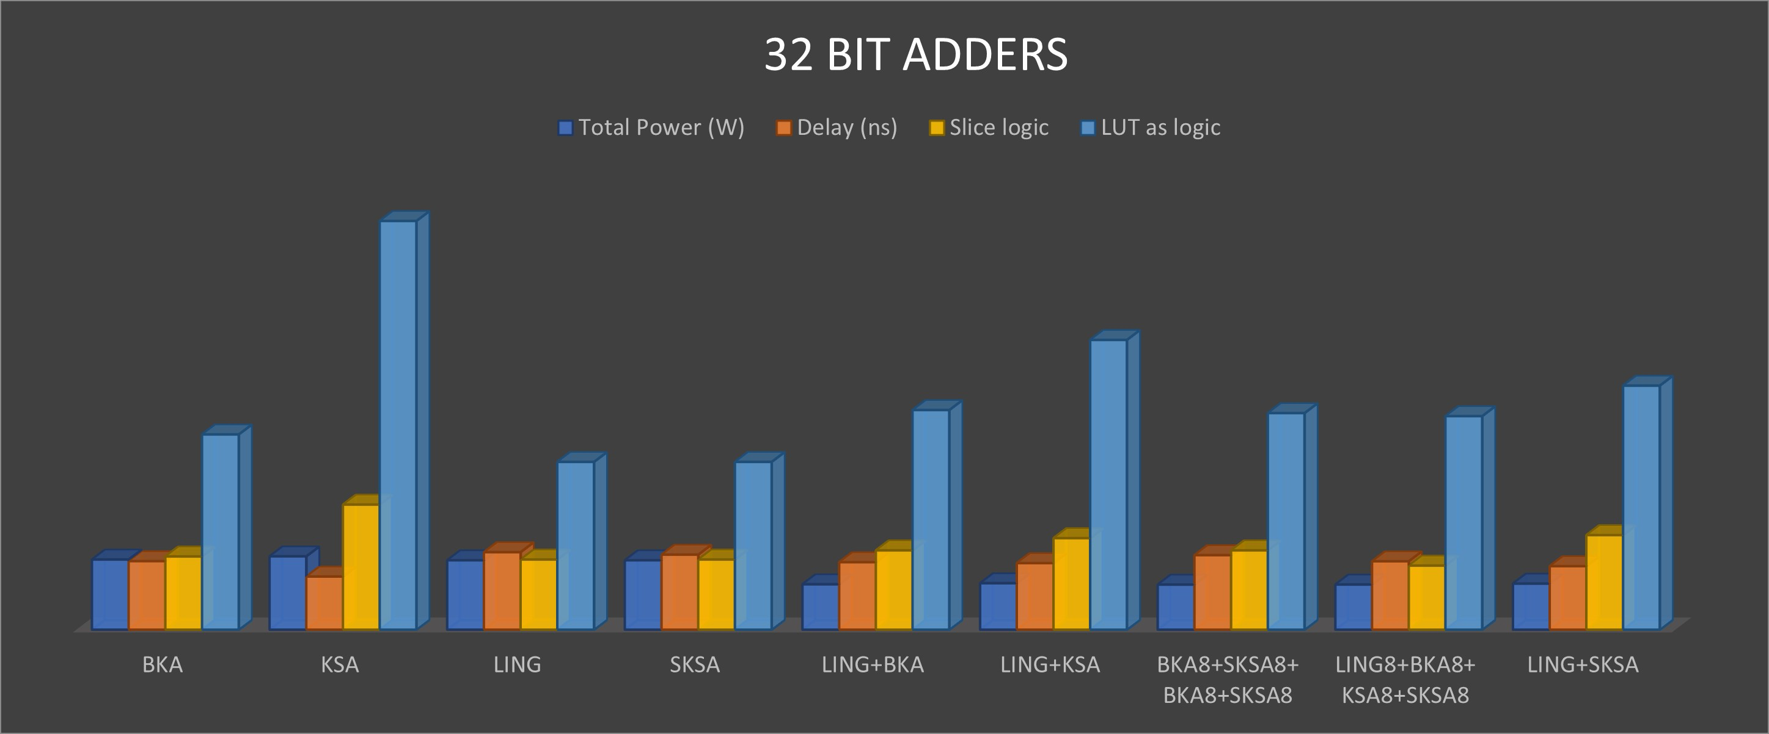
Bar graph of 32-bit Adders Results
Performance Improvement
32-bit Hybrid Adder vs. Ling Adder
Power Reduction: 33.63%
Delay Reduction: 18.60%
PDP Improvement: 45.64%
32-bit Hybrid Adder vs. Sparse Kogge–Stone Adder (SKSA)
Power Reduction: 33.63%
Delay Reduction: 15.36%
PDP Improvement: 43.82%

Slide 13
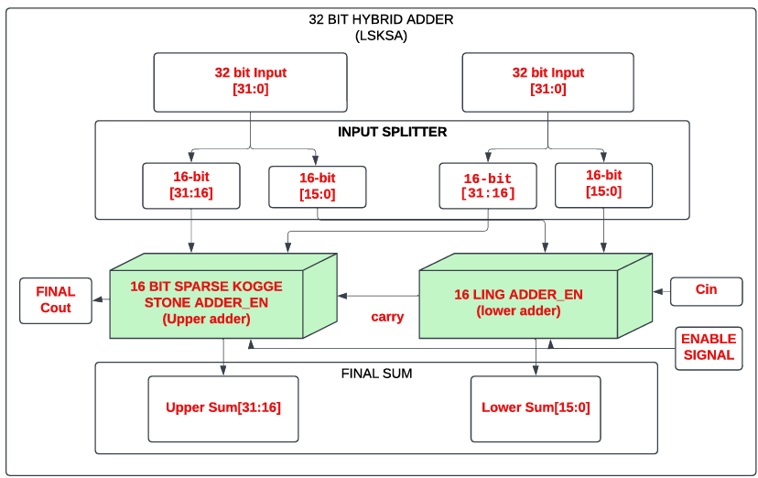
PROPOSED 32-Bit HYBRID ADDER ARCHITECTURE
LING(16) + SPARSE KOGGLE STONE(16)

Slide 14
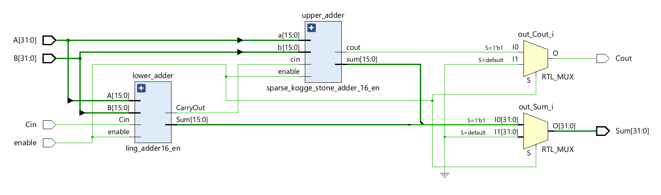
SCHEMATIC OF THE PROPOSED HYBRID ADDER

Slide 15
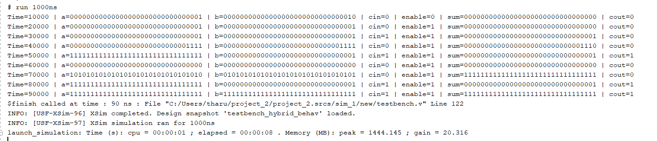
ADDITION RESULT OF HYBRID ADDER
TCL OUTPUT

Slide 16
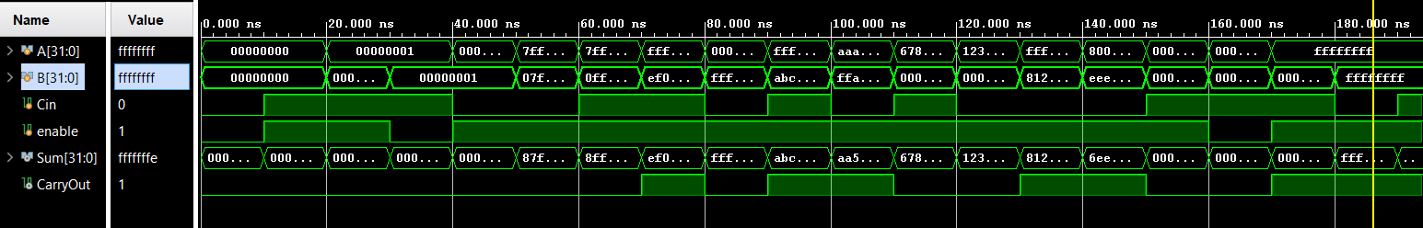
SIMULATION OUTPUT

Slide 17
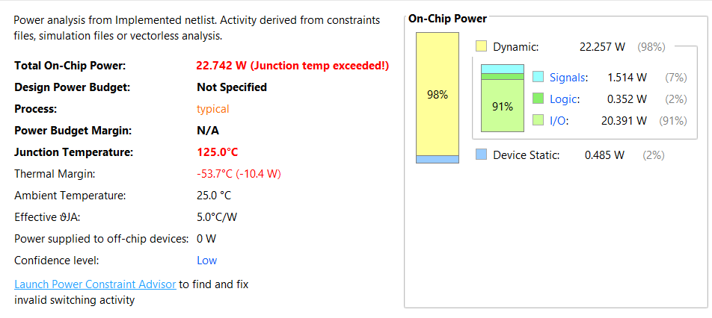
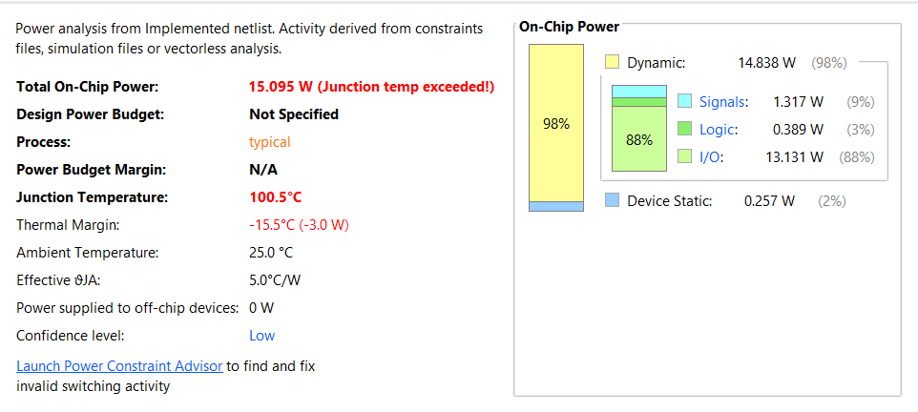
POWER COMPARISION OF 32- BIT LING ADDER AND PROPOSED HYBRID ADDER
32 BIT LING ADDER
32 BIT HYBRID ADDER

Slide 18
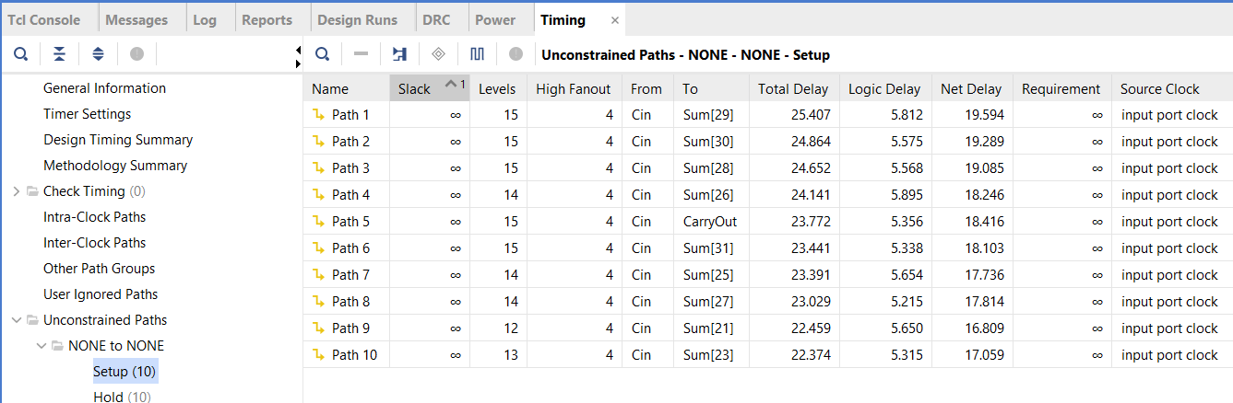
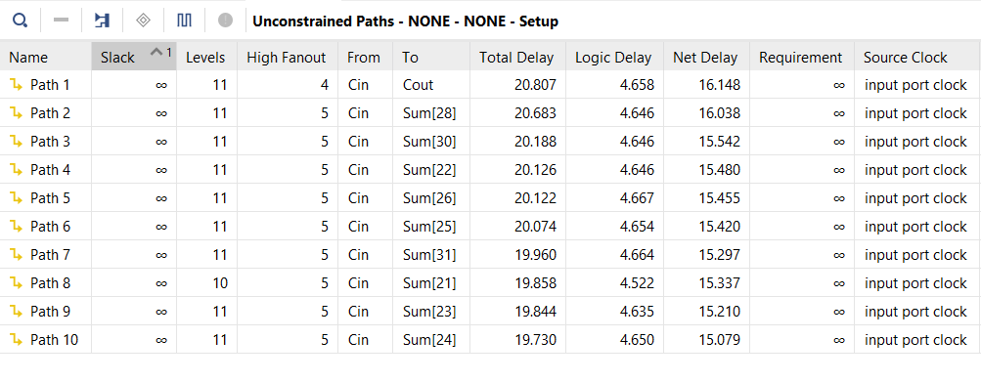
DELAY COMPARISION OF 32- BIT LING ADDER AND PROPOSED HYBRID ADDER
32 BIT LING ADDER
32 BIT HYBRID ADDER

Slide 19
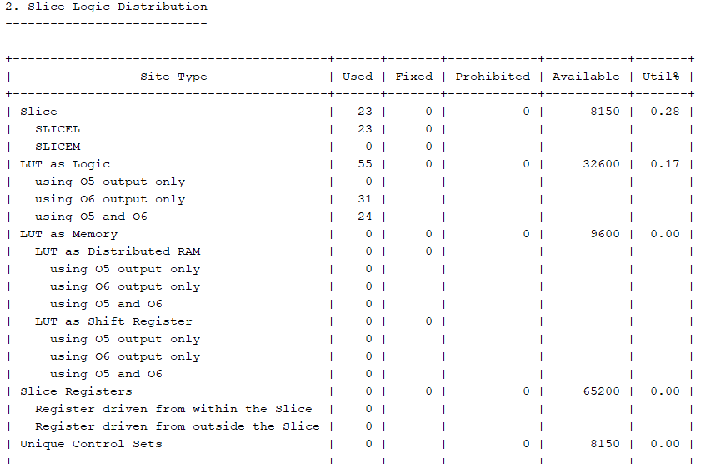
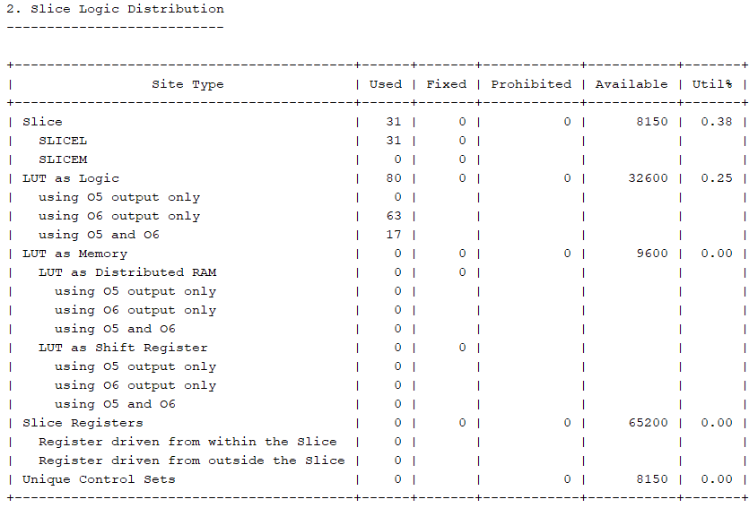
AREA COMPARISION OF 32- BIT LING ADDER AND PROPOSED HYBRID ADDER
32 BIT LING ADDER
32 BIT HYBRID ADDER

Slide 20
Hybrid Multiplier Design
Partial Product Generation
For all hybrid multiplier variants, 16 partial products are generated from 16-bit multiplicand and multiplier inputs using bitwise AND operations.
These partial products are generated using AND gates between bits of inputs A and B.
PP0 = A & {16{B[0]}}, PP1 = (A & {16{B[1]}}) << 1, ........ PP15 = (A & {16{B[15]}}) << 15.
For example, let’s multiply A (Multiplicand) = 1011 (11 in decimal) and B (Multiplier) = 1101 (13 in decimal):
1011 (Multiplicand – A)
× 1101 (Multiplier – B)
----------------------------------------------------------------------------
1011 (B [0] × A)
+ 00000 (B [1] × A, shifted 1 place)
+ 101100 (B [2] × A, shifted 2 places)
+ 1011000 (B [3] × A, shifted 3 places)
---------------------------------------------------------------------------
10001111 (Final Product - 143 in decimal)
The result is a set of 16 aligned partial binary values that need to be summed to produce the final product.
These are then summed using 32-bit hybrid adders based on the selected architectural scheme.

Slide 21
16 Bit Multipliers Results
Type | MULTIPLIER | Total Power (W) | Delay (ns) | Power Delay Product | Slice | LUT as logic
Conventional Multipliers | Dadda | 37.424 | 25.773 | 964.528 | 102 | 350
 | Karatsuba | 34.168 | 21.154 | 722.789 | 149 | 465
 | Wallace | 39.189 | 23.546 | 922.744 | 110 | 387
 | Vedic | 32.122 | 19.527 | 627.246 | 109 | 334
Hybrid Multipliers With Enable | Hybrid multiplier Parallel addition with all 4 adders | 33.827 | 25.573 | 865.057 | 183 | 644
 | Hybrid multiplier Serial addition with all 4 adders | 13.898 | 42.897 | 596.182 | 231 | 778
 | Hybrid multiplier 4 chain tree addition with all 4 adders | 13.355 | 29.783 | 397.751 | 216 | 743
 | Hybrid multiplier 4 chain tree addition with LKSA | 13.118 | 28.400 | 372.551 | 228 | 774
 | Hybrid multiplier 4 chain tree addition with LBKA | 32.572 | 25.490 | 830.260 | 156 | 543
 | Hybrid multiplier 2 chain tree addition with all | 13.555 | 31.761 | 430.520 | 224 | 780
 | Hybrid multiplier 4chai tree addition with LSKSA hyd_adr (Proposed) | 12.073 | 30.375 | 366.717 | 158 | 529

Slide 22
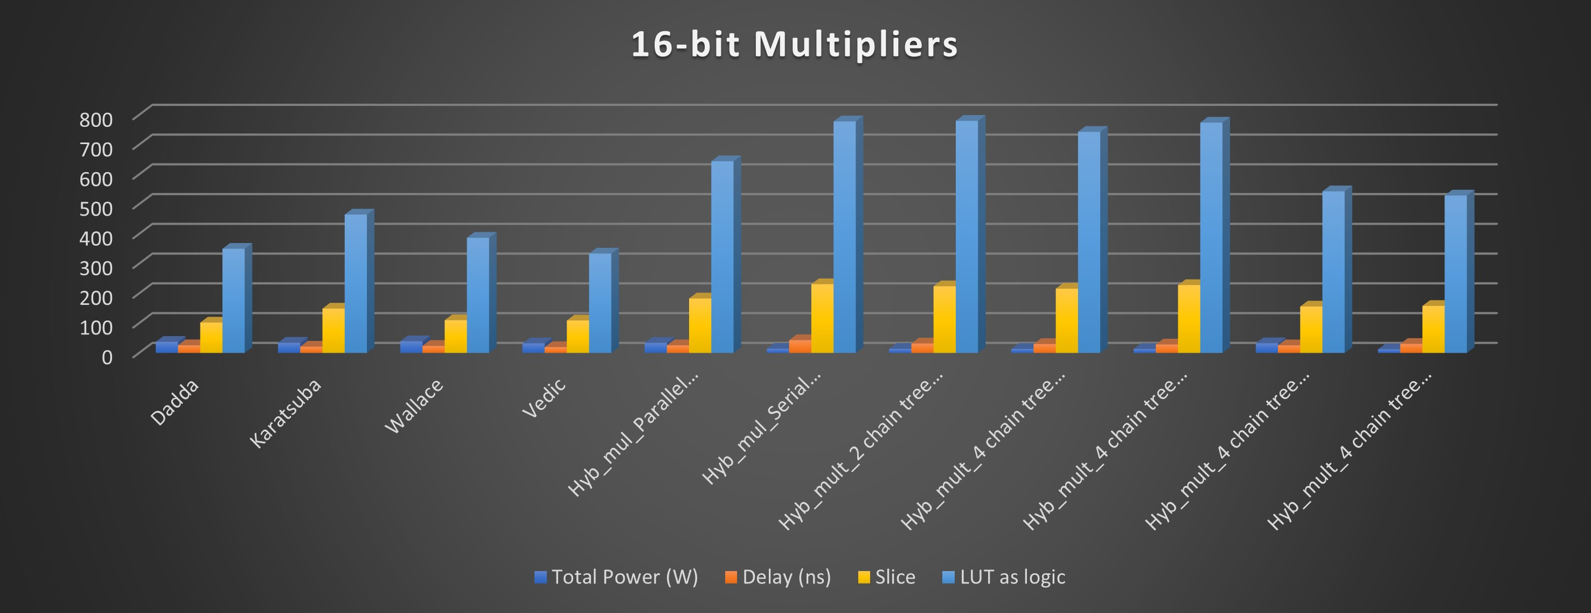
Bar graph of 16-bit Multipliers Results
Performance Improvement
16-bit Hybrid Multiplier vs. Conventional Multipliers
Power Reduction (Vedic): 62.42%
PDP Improvement (Vedic): 41.54%
Power Reduction (Wallace Tree): 69.19%
PDP Improvement (Wallace Tree): 60.26%

Slide 23
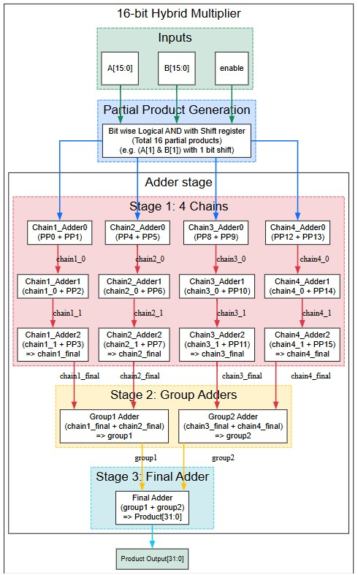
PROPOSED HYBRID MULTIPLER Architecture

Slide 24
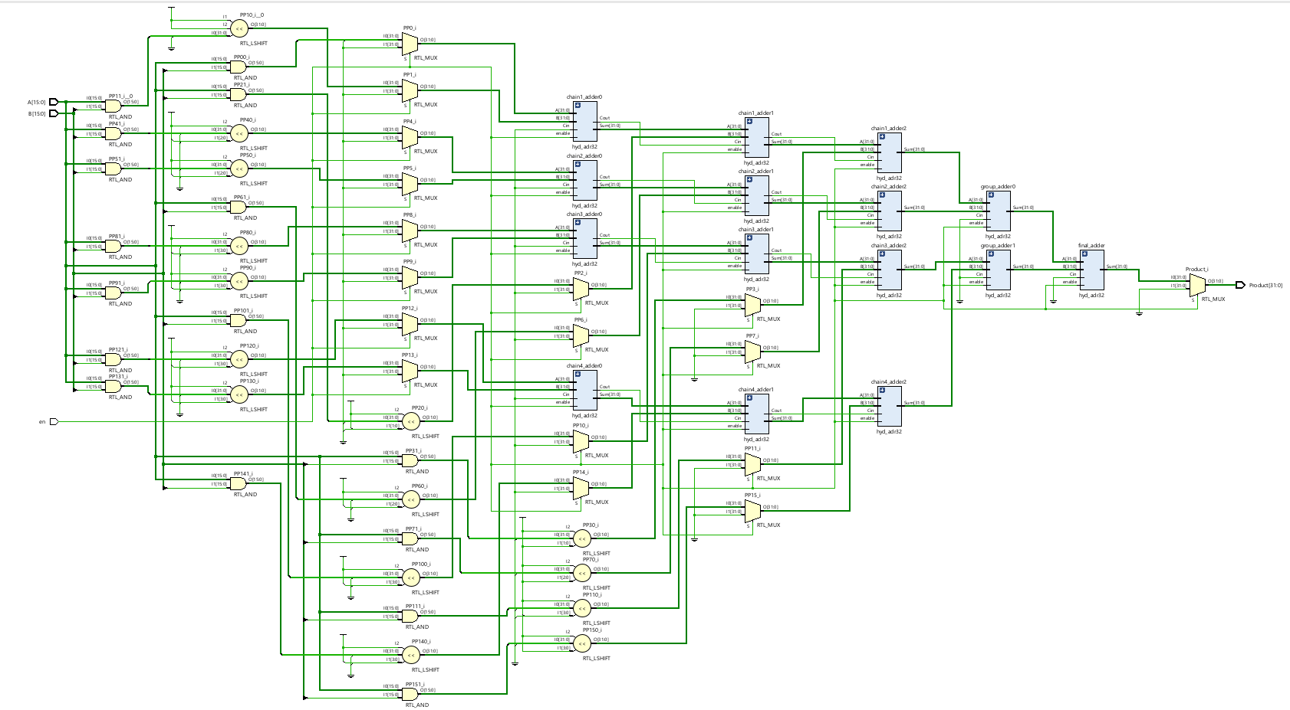
PROPOSED HYBRID MULTIPLER
SCHEMATIC OF THE PROPOSED HYBRID MULTIPLER

Slide 25
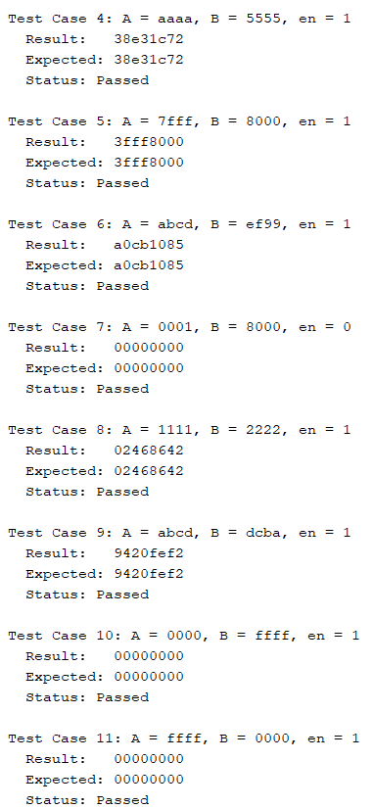
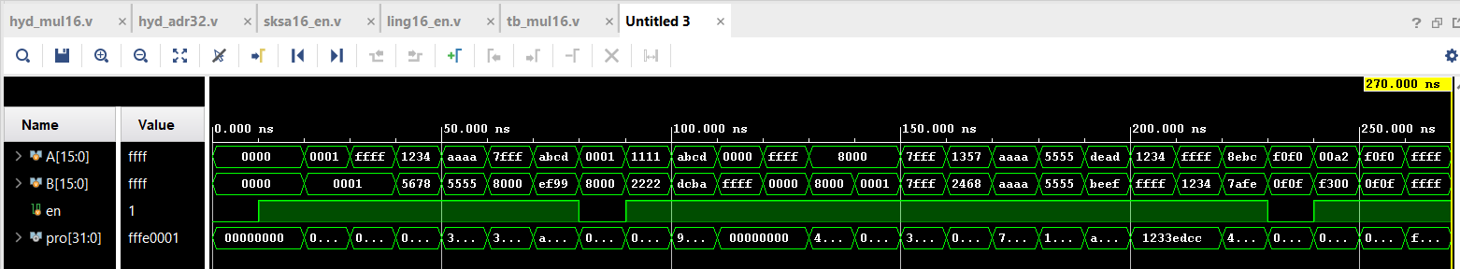
MULTIPLICATION RESULT OF HYBRID MULTIPLER
SIMULATION OUTPUT
TCL OUTPUT

Slide 26
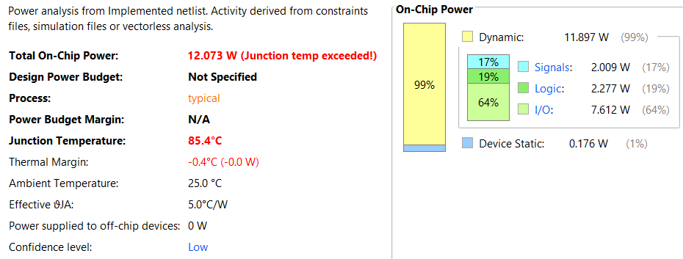
POWER OF 16 - BIT PROPOSED HYBRID MULTIPLER

Slide 27
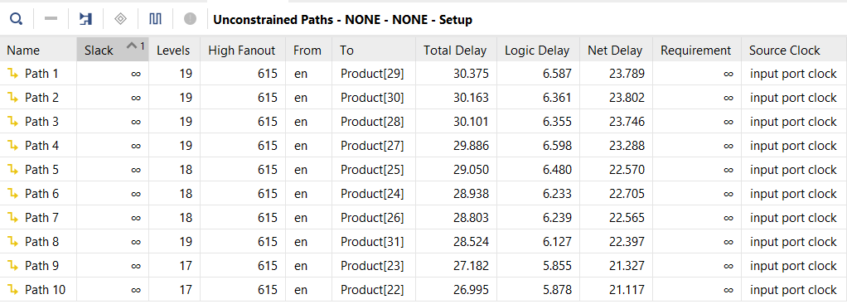
DELAY OF 16 - BIT PROPOSED HYBRID MULTIPLER

Slide 28
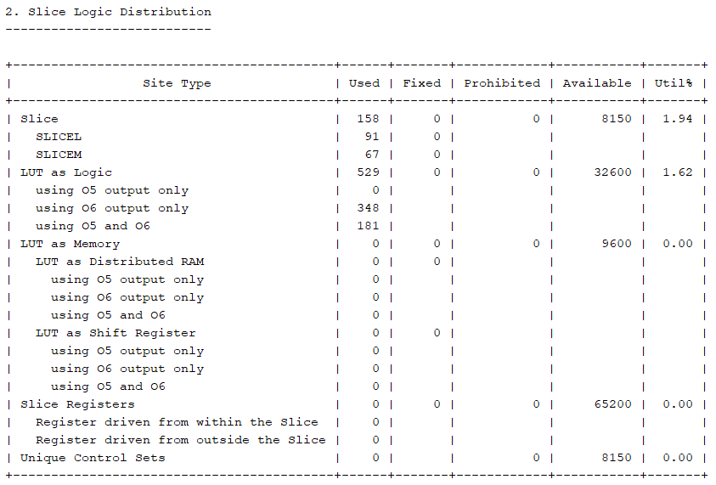
AREA OF 16- BIT PROPOSED HYBRID MULTIPLER

Slide 29
16 tap FIR filter of with 16 bit input
Type | Lowpass FIR Filter 16tap | Tot Power (w) | Delay (ns) | Power Delay Product | Slice logic | LUT logic | Slice Register
Without timing constraints | Fir Direct arithmetic | 36.929 | 35.436 | 1308.616 | 78 | 104 | 234
 | Fir_parallel_addition | 26.076 | 30.127 | 785.591 | 269 | 883 | 265
 | Fir_serial_addition | 23.806 | 38.870 | 925.339 | 285 | 970 | 267
 | Fir_tree_addition | 23.316 | 31.102 | 725.174 | 279 | 913 | 265
 | Enhanced Fir filter (Enabled delay) | 5.975 | 30.928 | 184.794 | 267 | 903 | 265
With timing constraints | Fir Direct arithmetic with timing constraints 28.571 MHz (35ns period) | 0.081 | 33.177 | 2.687 | 75 | 104 | 234
 | Enhanced Fir filter With timing constraints 33.333 MHz (30nsperiod) | 0.075 | 22.065 | 1.654 | 201 | 921 | 265

Slide 30
Bar graph of 16 tap FIR Filter
Performance Improvement
Compared to a FIR filter using direct arithmetic operators without any constraints:
Power Consumption Reduced by: 83.82%
Delay Reduced by: 12.72%
Power-Delay Product Improved by: 85.87%

Slide 31
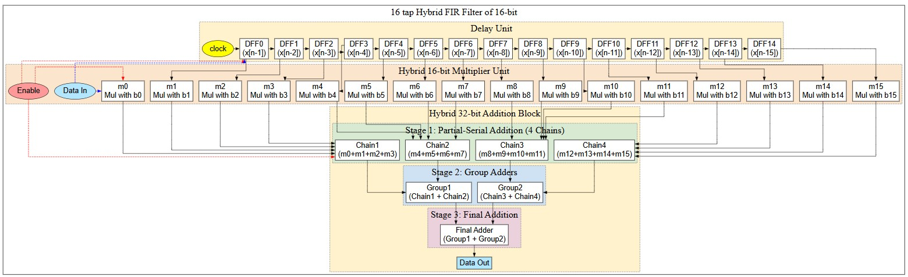
PROPOSED Low Pass FIR Filter Architecture

Slide 32
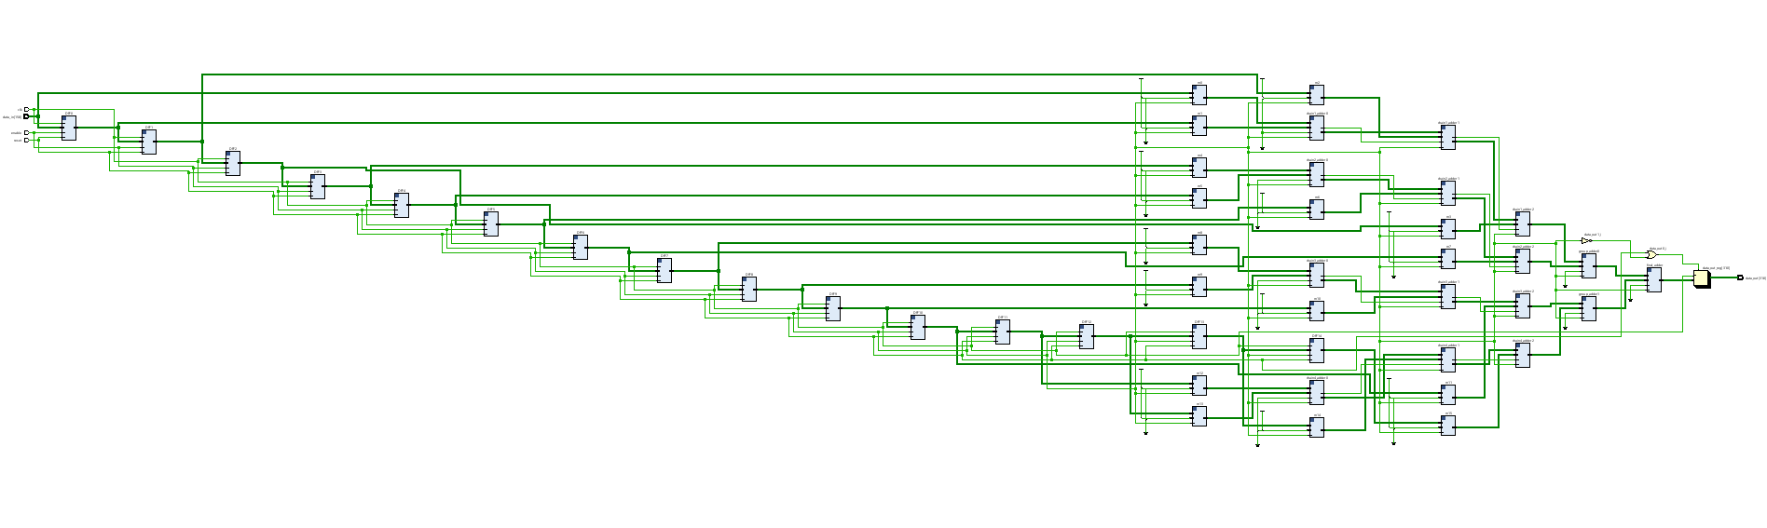
PROPOSED Low Pass FIR Filter Schematic

Slide 33
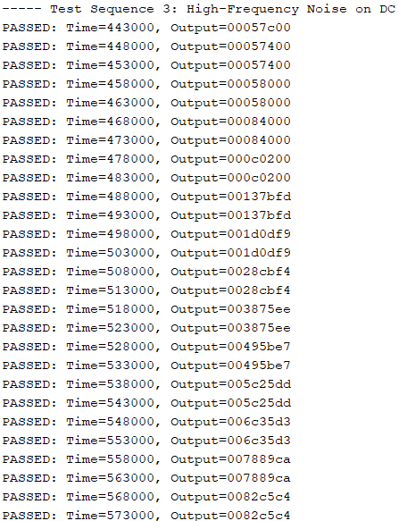
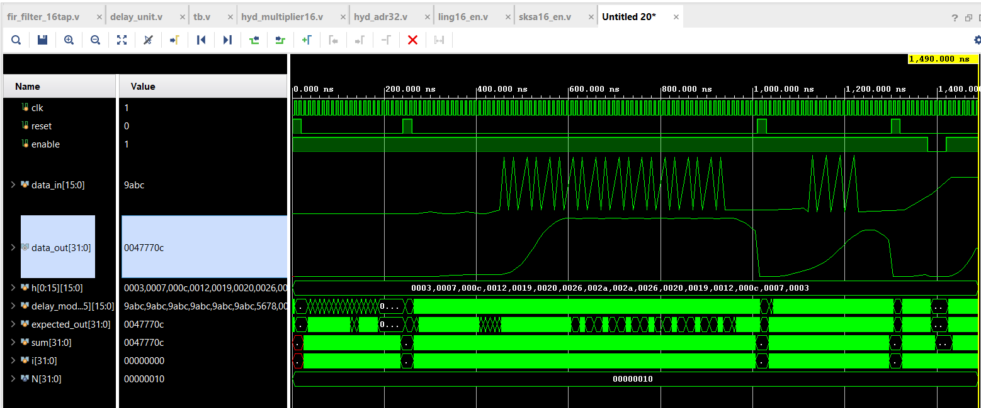

TCL OUTPUT
ANALOG WAVE FORM

Slide 34
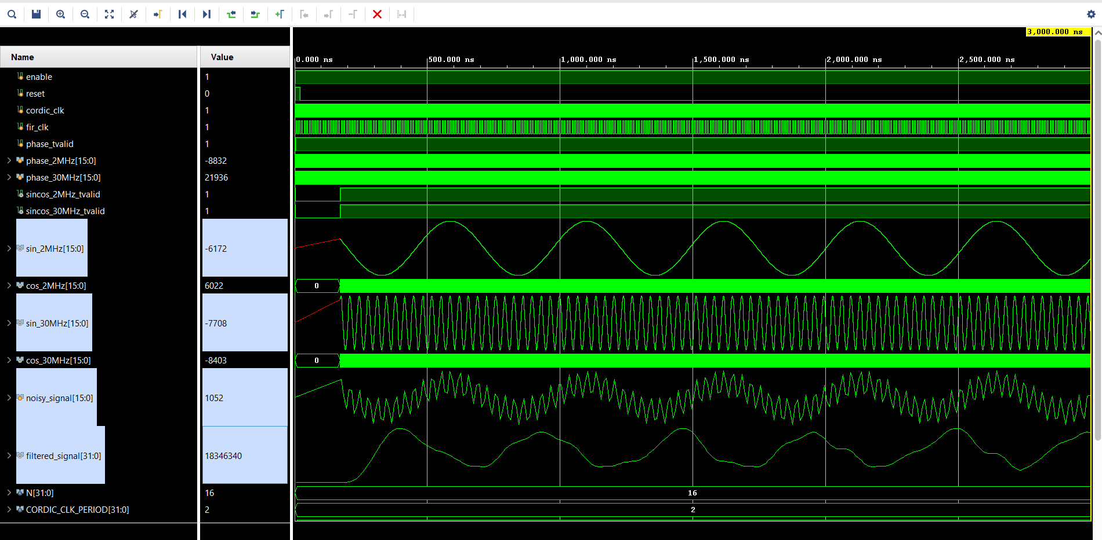

LOW PASS OUTPUT

Slide 35
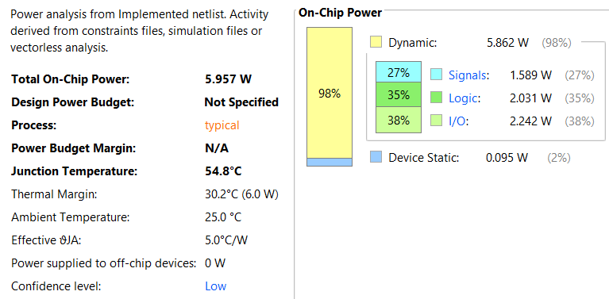
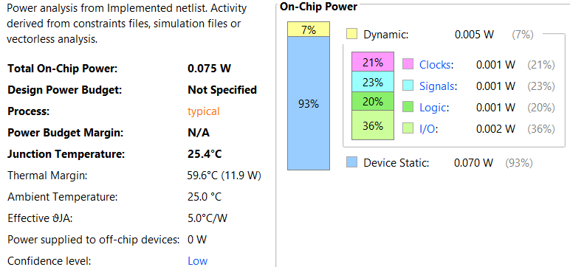
Power With out Time constraints
Power With Time constraints

Slide 36
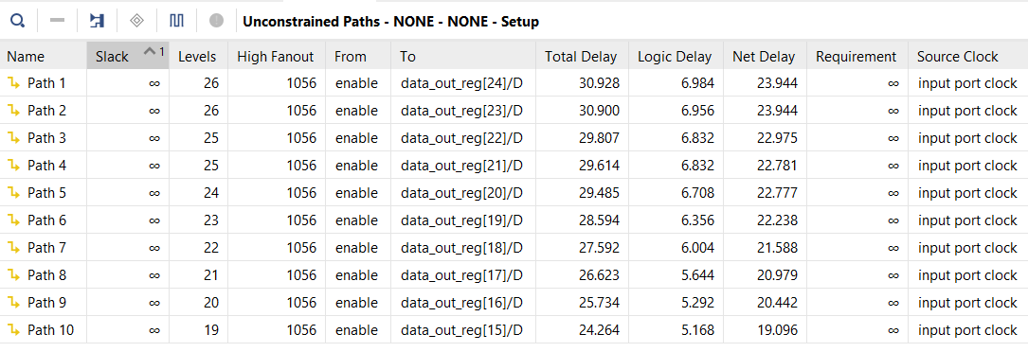
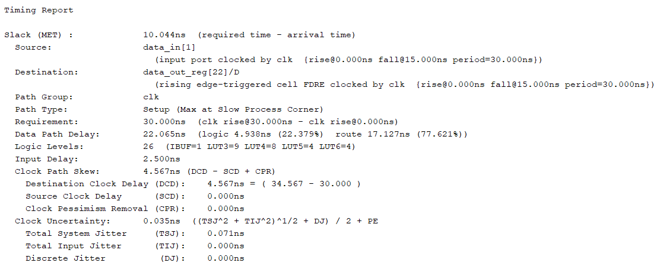
Timing With out Time constraints
Timing With Time constraints

Slide 37
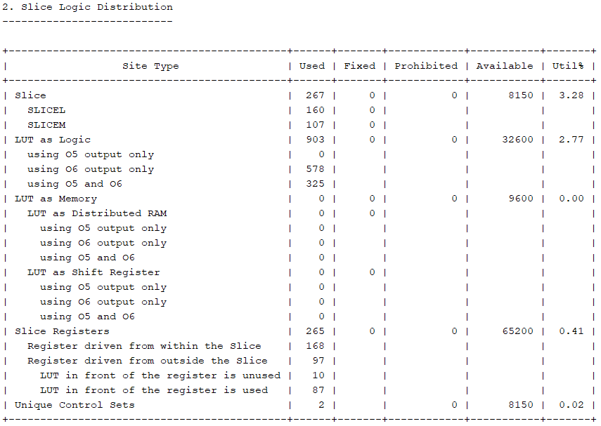
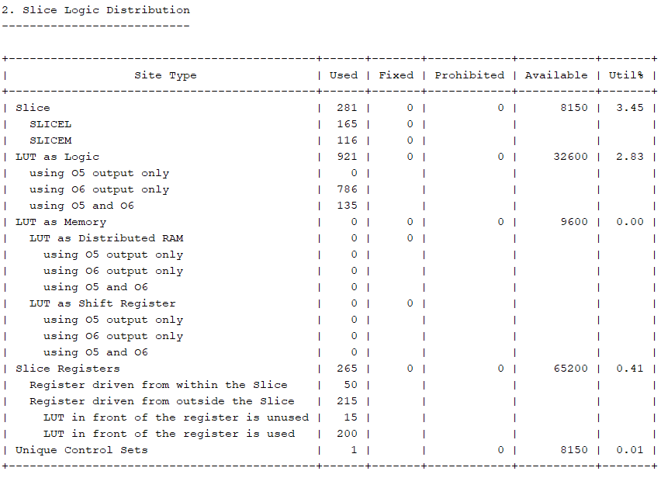
Area With out Time constraints
Area With Time constraints

Slide 38
Challenges Faced
Future Scope
Complex Design Integration:
Incorporating multiple hybrid adder and multiplier architectures within a single FIR filter design increased system complexity and required careful coordination of data paths.
Trade-Off Analysis:
Balancing power consumption, area usage, and processing speed proved challenging, as optimizing one metric often impacted the others.
Verification and Debugging:
Ensuring functional correctness and performance consistency demanded extensive simulation, testbench development, and iterative refinement of the filter architecture.
1. Accurate Power Profiling:
To complement the current estimates, future implementations should incorporate complete pin constraints and switching activity data (.saif or .vcd) to enable precise dynamic power analysis and real-world energy profiling.
2. Application-Specific Filter Customization:
The symmetric coefficient set can be further tuned or dynamically reconfigured to suit various real-time biomedical, audio, or image-processing applications.
3. Scalability and Bit-Width Extension:
The proposed 32-bit hybrid adder and 4-chain multiplier structures can be extended to higher word lengths, enabling broader applicability in high-performance DSP systems.

Slide 39
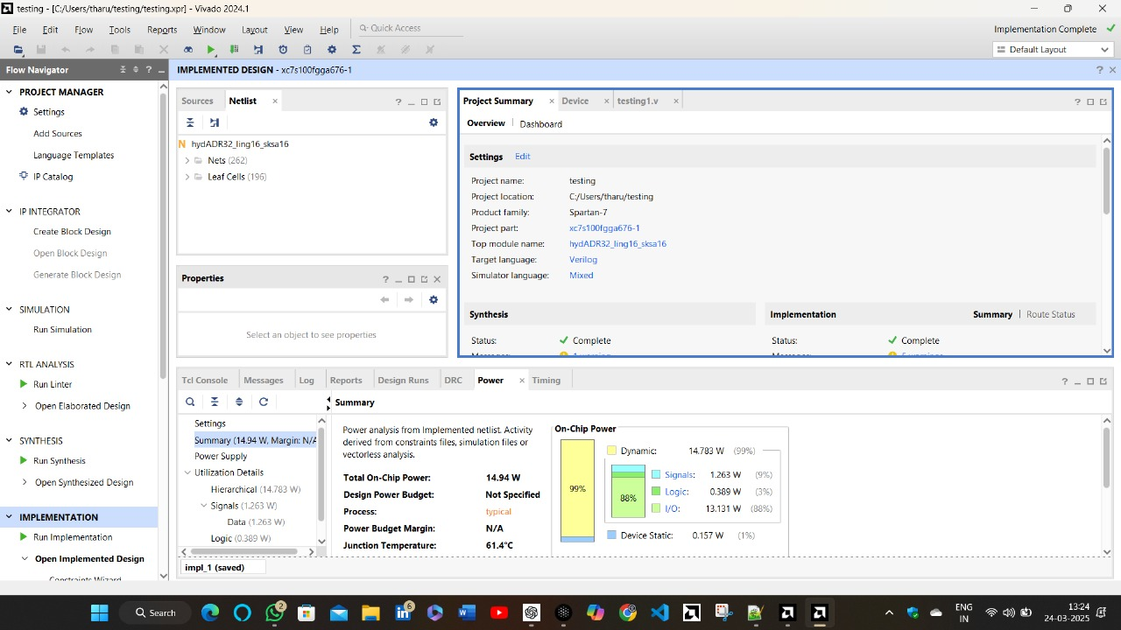
Proposed Hybrid Adder power in Spartan 7 board

Slide 40
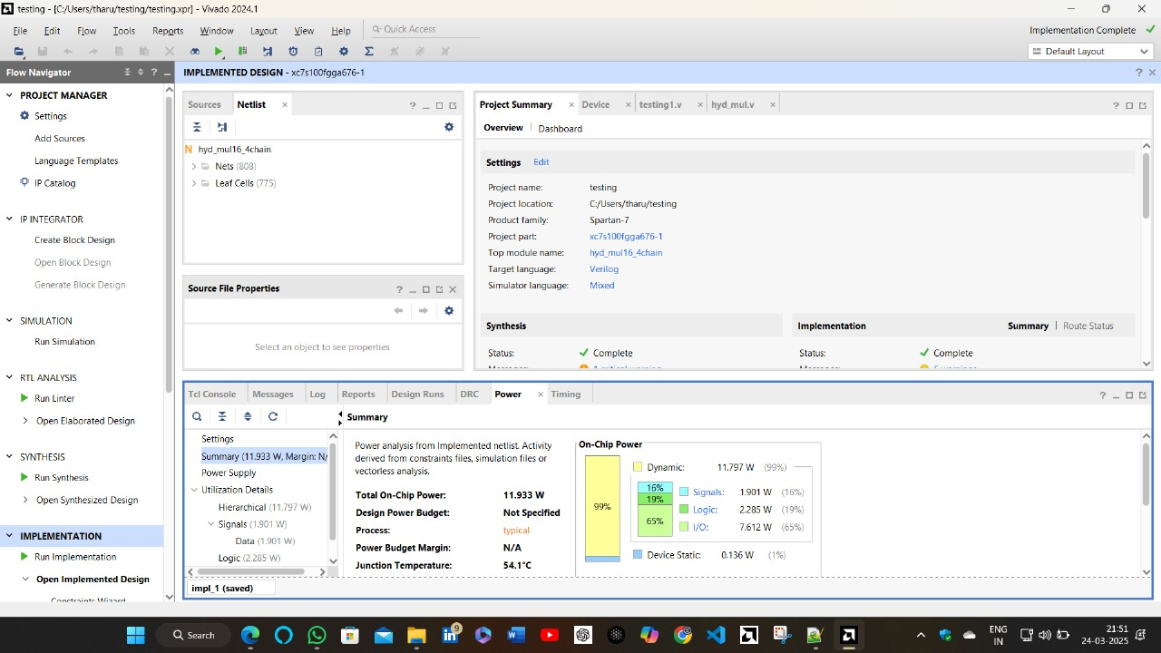
Proposed Hybrid Adder power in Spartan 7 board

Slide 41
Conclusion
Component | Metric | Conventional Design | Proposed Hybrid Design Improvement
16-bit adders | Power Consumption | Ling adder | 25.79% reduction
 | Delay | Ling adder | 6.797% reduction
 | Power delay product | Ling adder | 30.836% reduction
32-bit Adder | Power Consumption | Ling adder | 33.63% reduction
 | Delay | Ling adder | 18.6% reduction
 | Power delay product | Ling adder | 45.64% reduction
 | Power Consumption | Sparse Kogge–Stone adder | 33.63% reduction
 | Delay | Sparse Kogge–Stone adder | 15.36% reduction
 | Power delay product | Sparse Kogge–Stone adder | 43.82% reduction
16-bit Multiplier | Power Consumption | Vedic Multiplier | 62.415% reduction
 | Power Consumption | Wallace Tree Multiplier | 69.192% reduction
16-bit 16 tap FIR Filter | Power Consumption | Arithmetic Operators | 83.82% reduction
 | Delay | Arithmetic Operators | 12.721% reduction
 | Power-Delay Product (PDP) | Arithmetic Operators | 85.87% reduction

Slide 42
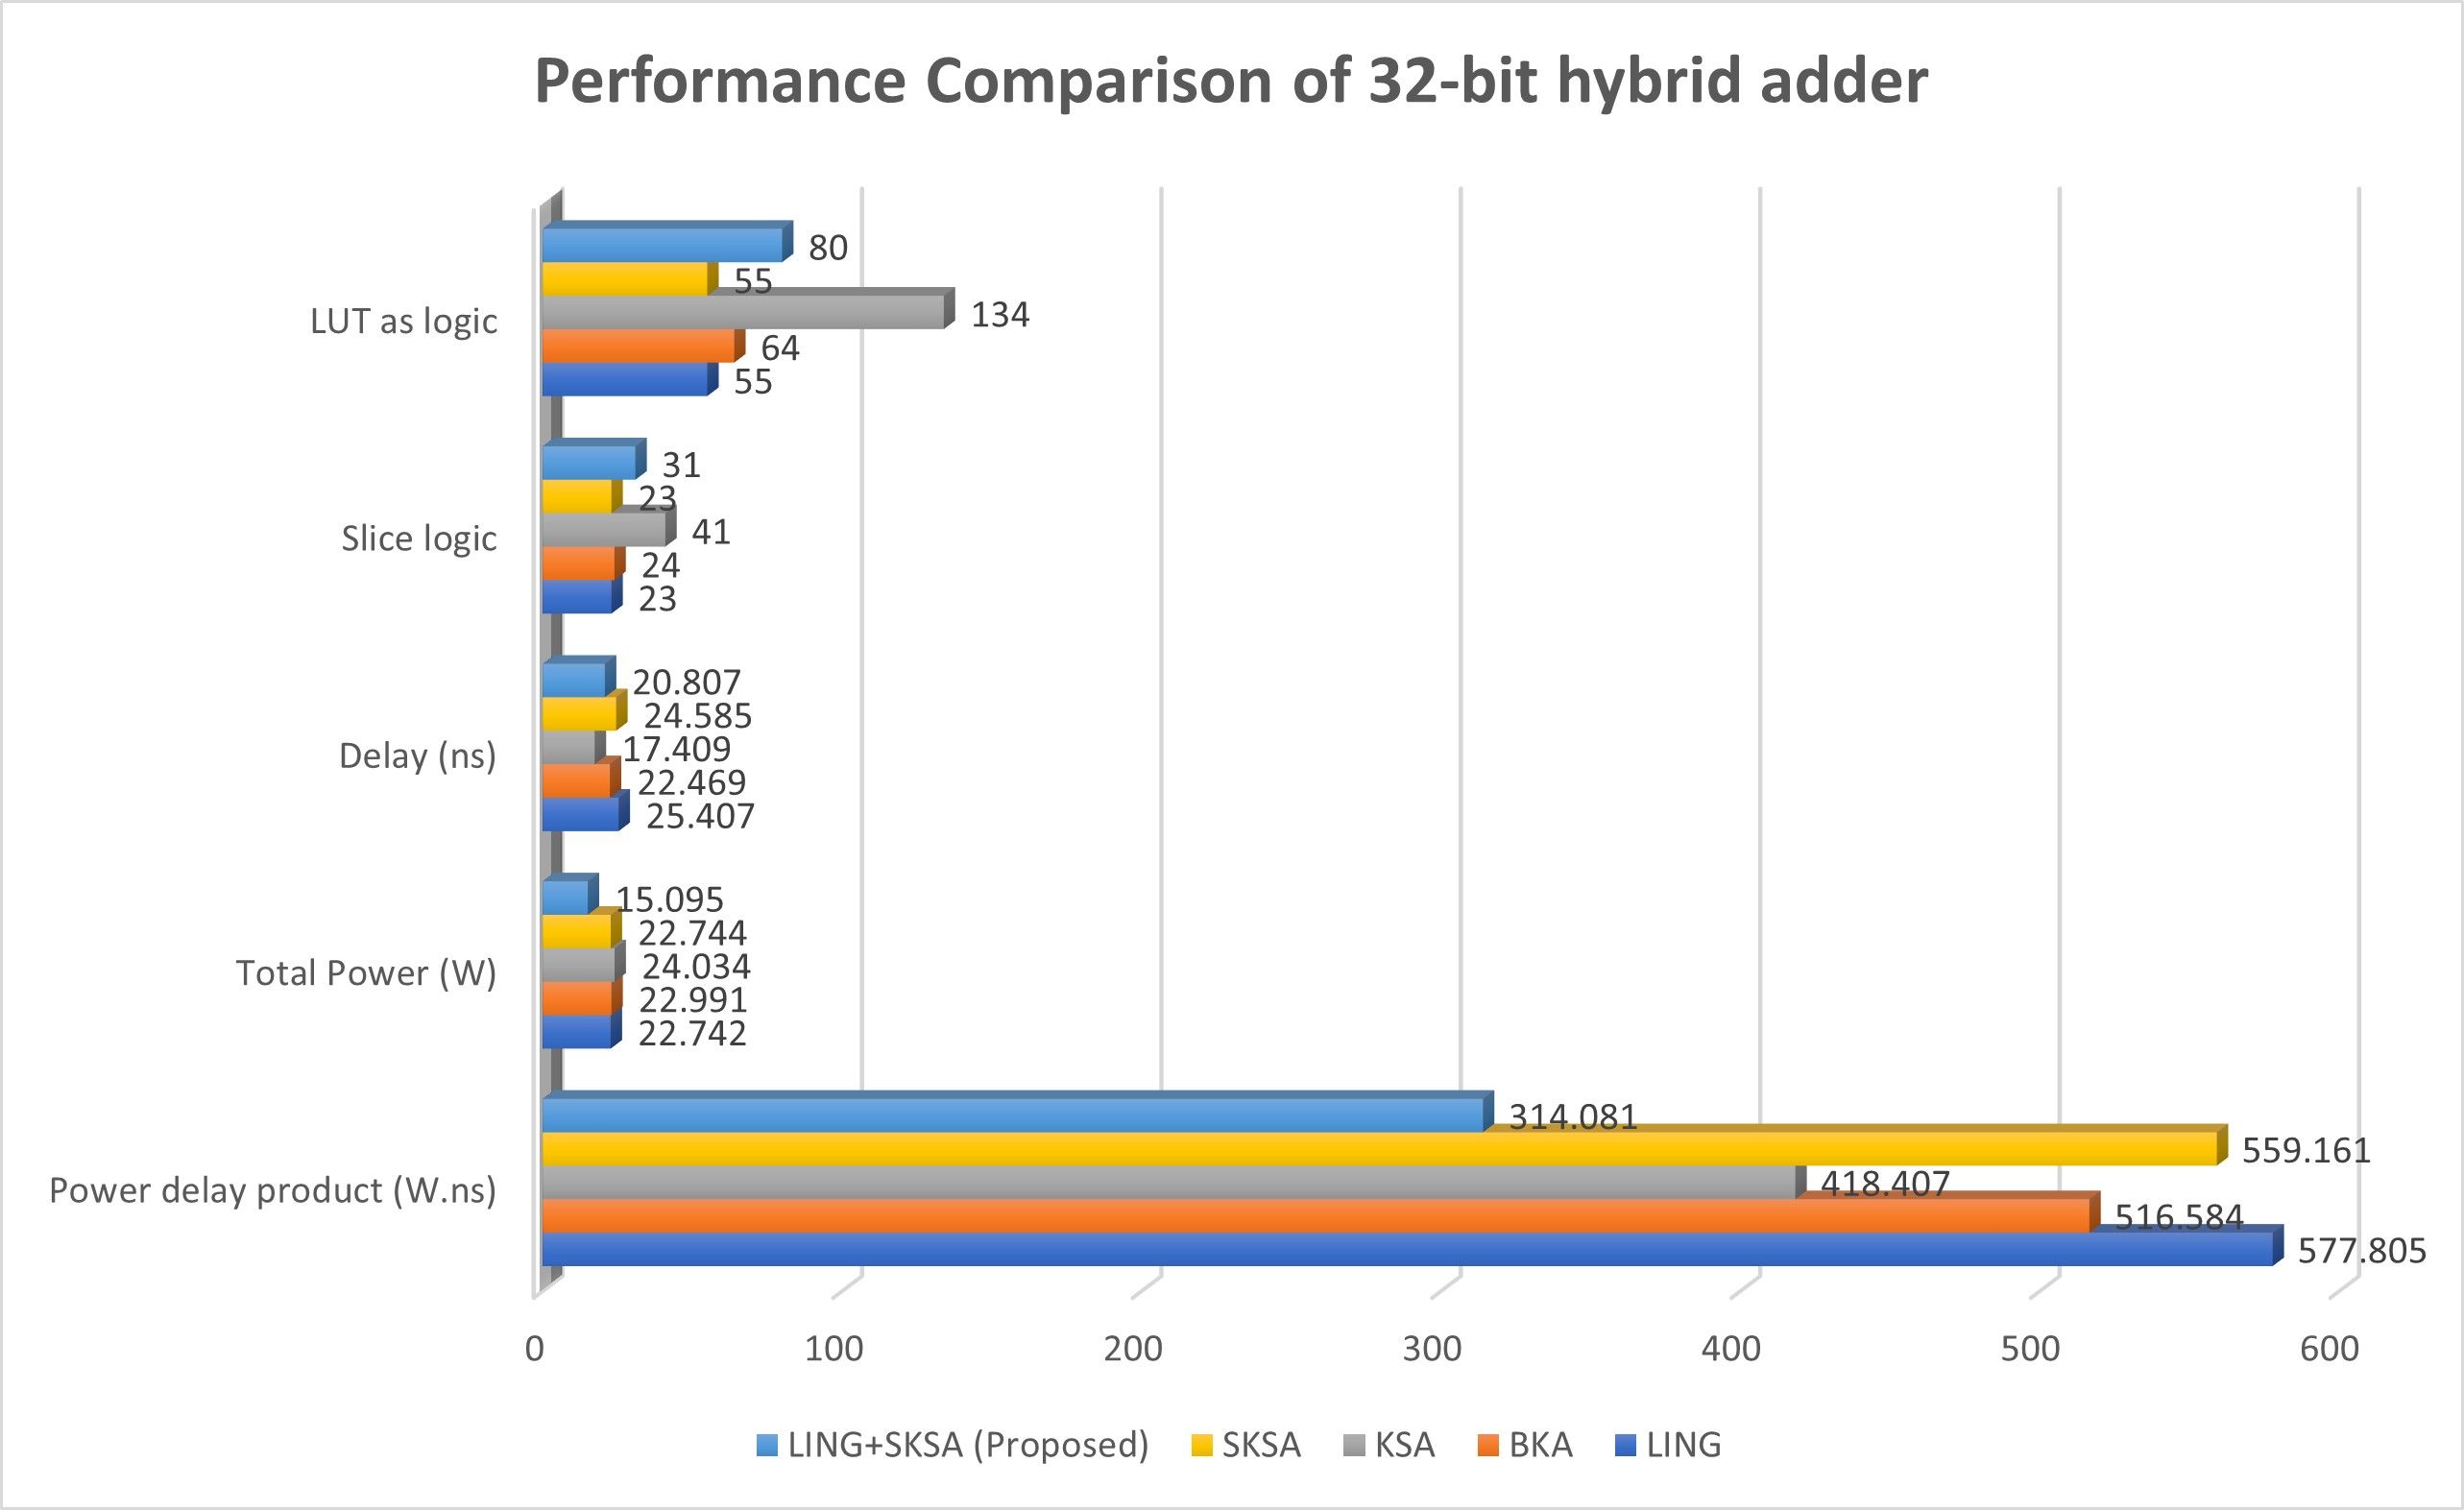
Conclusion

Slide 43
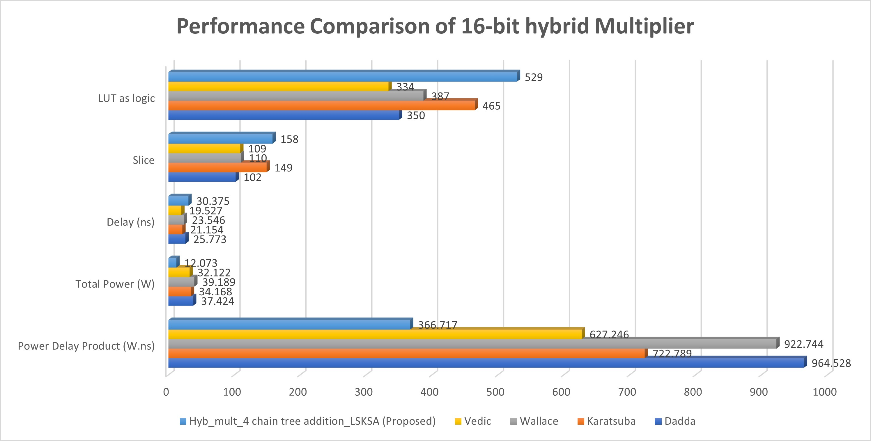
Conclusion

Slide 44
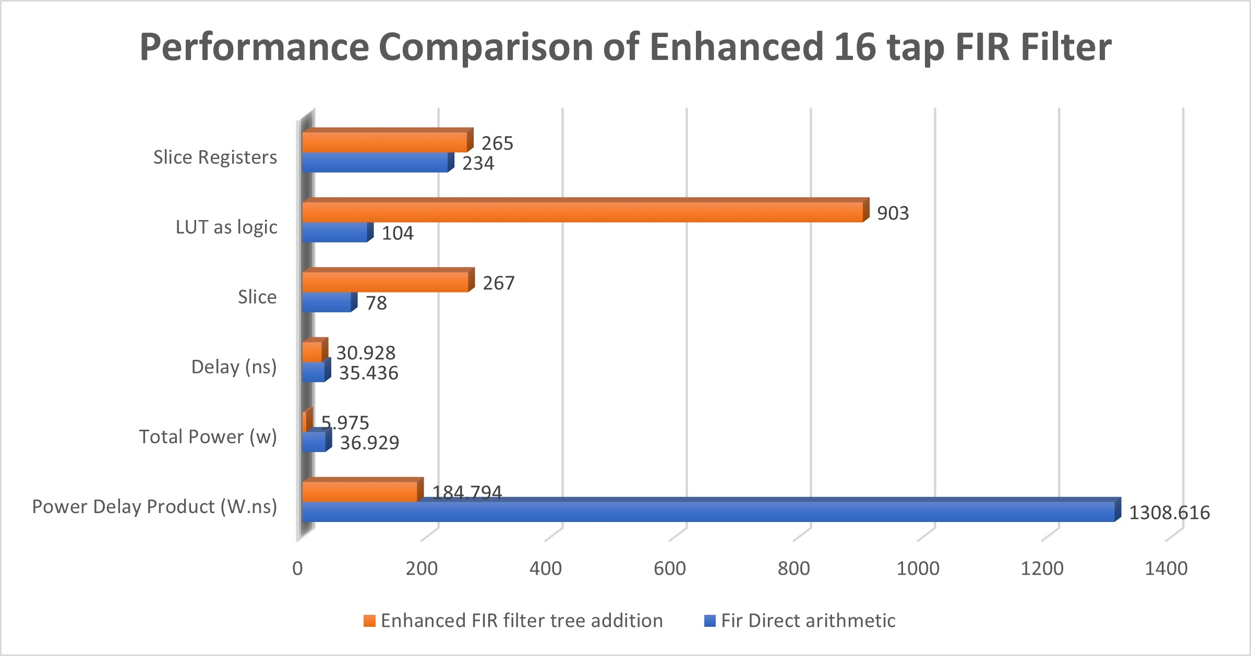
Conclusion

Slide 45
Conclusion
The proposed hybrid design in this work exhibits remarkable enhancement in all of its components. Our 32-bit hybrid LKSA adder achieves a 45.64% decrease in power–delay product (PDP) compared to conventional Ling adders and a 43.82% decrease compared to the traditional Sparse Kogge-Stone adder.
Additionally, the 16-bit hybrid multiplier realized by a 4-chain tree addition technique achieves a 62.42% decrease in power dissipation compared to a standard 16-bit Vedic multiplier.
When applied to FIR filter design, these optimized arithmetic units yield a filter that realizes an overall 85.87% reduction in PDP, with the power consumption reduction being 83.82% and delay reduction being 12.721% relative to a regular FIR filter employing basic arithmetic operations.
Besides, under timing constraints, the optimized design achieves an extra 7.40% power saving, a 33.49% delay saving, and a 38.44% PDP saving at 33.33 MHz. These results show that the proposed design is suitable for low-power DSP applications.
In conclusion, the proposed FIR filter with a hybrid Adder and Multiplier architecture offers a robust, energy-efficient, and high-performance alternative to traditional designs, with flexibility for adaptation to a wide range of signal processing tasks.

Slide 46
Monthly Work Plan:
Month | Activity | Status
July | Project Selection | Completed
August | Literature Review | In Process
September | Initial Design Concepts | Completed
October | Hybrid Adder Design | Completed
November | Optimization of Hybrid Adder | Completed
December | Hybrid Multiplier Design | Completed
January | Optimization of Hybrid Multiplier | Completed
February | Design of FIR Filter | Completed
March | Paper work and Documentation | Completed

Slide 47
References
Sinthura, S. S., et al., Implementation and Analysis of Different 32-Bit Multipliers on Aspects of Power, Speed, and Area. GRD Journals.
Yong, K. M., et al., 2021, Design and Analysis of 32-Bit Signed and Unsigned Multiplier Using Booth, Vedic, and Wallace Architecture. Journal of Physics: Conference Series.
Deshpande, N. G., & Mahajan, R., Ancient Indian Vedic Mathematics Based 32-Bit Multiplier Design for High Speed and Low Power Processors. International Journal of Computer Applications.
M. Nisha Angeline and S. Valamarthy Implementation of Hybrid Vedic Multiplier Nikhilam Sutra and Karatsuba Algorithm for N-bit Multiplier. Asian Journal of Information Technology.
Srinivasan, M., & Prakasam, P., A Detailed Survey on Various Efficient Multipliers in Low Power VLSI Circuit. International Journal of Applied Engineering Research.
Syed Shahzad Hussain Shah, Muhammad Naseem Majoka, and Gulistan Raja., DESIGN AND IMPLEMENTATION OF 32-BIT VEDIC MULTIPLIER ON FPGA. First International Conference on Modern Communication & Computing Technologies (MCCT'14).
M.Bala Murugesh, S.Nagaraj, J.Jayasree, G.Vijay Kumar Reddy., Modified High Speed 32-bit Vedic Multiplier Design and Implementation. Proceedings of the International Conference on Electronics and Sustainable Communication Systems (ICESC 2020).
Nishant G. Deshpande, Rashmi Mahajan., Ancient Indian Vedic Mathematics based 32-Bit Multiplier Design for High Speed and Low Power Processors. International Journal of Computer Applications (0975 – 8887) Volume 95– No.24, June 2014.

Slide 48
References
Shankar R , Sundhararajan G , Vignesh S, Aravind AR., FPGA Implementation Of Karatsuba Vedic Multipliers. IJARIIE-ISSN(O)-2395-4396, Vol-7 Issue-2 2021.
R.K.Sharma, Arish S., An efficient floating point multiplier design for high speed applications using Karatsuba algorithm and Urdhva-Tiryagbhyam algorithm.
Renjith R, Benson Biju, Ancy Joy, Vaishavi Ganeshan and Sivasankar R. “Design and Performance Analysis of Various 32-bit Hybrid Adders using Verilog.” | 2022 IEEE International Conference on Signal Processing, Informatics, Communication and Energy Systems (SPICES) | 978-1-6654-4940-3/22/$31.00 ©2022 IEEE | DOI: 10.1109/SPICES52834.2022.9774131
Juthi Farhana Sayed1, Bhuiyan Hasibul Hasan, Babul Muntasir, Mehedi Hasan, Farhadur Arifin “Design and Evaluation of a FIR Filter Using Hybrid Adders and Vedic Multipliers” | 2021 2nd International Conference on Robotics, Electrical and Signal Processing Techniques (ICREST) | 978-0-7381-3042-2/20/$31.00 ©2021 IEEE | DOI: 10.1109/ICREST51555.2021.9331063
S.Naga Leela, Dorsela Keerthi Chandrika, Kasireddy Swetha, Dhanush Goud Kalali and G.Shanthi. “A Novel Design of High Speed Multiplier Using Hybrid Adder Technique.” | 2024 3rd International Conference for Innovation in Technology (INOCON) | 979-8-3503-8193-1/24/$31.00 ©2024 IEEE | DOI: 10.1109/INOCON60754.2024.10512237
Veena M B, Pramath Akkamanchi and Vighneshkumar Uttarakar. “Low Power High Speed Brent Kung Adder Using SPST” |2022 IEEE 3rd Global Conference for Advancement in Technology (GCAT) | 978-1-6654-6855-8/22/$31.00 ©2022 IEEE | DOI: 10.1109/GCAT55367.2022.9971848
Shanmugaraja T and Kathikeyan N “Power Effective Multiply Accumulation Configuration For Low Power Applications Using Modified Parallel Prefix Adders “ | 2023 International Conference on Applied Intelligence and Sustainable Computing (ICAISC) | 979-8-3503-2379-5/23/$31.00 ©2023 IEEE | DOI: 10.1109/ICAISC58445.2023.10200142
S Ning Shang , Zhou Wang , Ruikang Liu , Yizhou Huang, Yin Zhang , Zhangqing He, Meilin Wan “A 32-Bit Ripple-Ling Hybrid Carry Adder”|IEEE TRANSACTIONS ON CIRCUITS AND SYSTEMS—I: REGULAR PAPERS, VOL. 71, NO. 6, JUNE 2024

Slide 49


